Slide 1

A Comparative Sentiment Analysis of
Colloquium
Purwadi, Henny
DIGITAL and Robot Pet COMPANIONS
in Various Locations
Indonesia, 21-07-2023

Slide 2
Agenda fOr THESIS
Introduction |  | 1
Literature Review |  | 2
Methodology |  | 3
Results Findings and Analysis |  | 4
Discussions |  | 5
Conclusions |  | 6
Bibliography |  | 7

Slide 3
Abstract
Compared different machine learning models for sentiment analysis on a labeled trained dataset and chose the best performance model.
Collect an unlabeled Twitter dataset about digital robot companions from various regions, and apply a chosen machine learning model to figure out sentiments in the unlabeled dataset.
Chi-square test is used to find out dependencies between sentiment and various locations.

Slide 4
1. Introduction
01

Slide 5
RESEARCH QUESTIONs
1. Will the majority of sentiments about digital and robot pet companions be positive, like joy & love, or will be negative, like anger & fear?
2. Does location or region influence people's sentiments towards digital and robot pet companions?

Slide 6
2. Literature Review
02

Slide 7
2.1 Overview of Relevant Previous Studies
Why Do We Turn to Virtual Companions? A Text Mining Analysis of Replika Reviews. Siemon, Strohmann, Khosrawi-Rad, Elshan, de Vreede, & Meyer. (2022, July 11).
Based on 119,831 reviews of Replika AI chatbot that previous researchers had collected from the Google Play Store and then subjected to sentiment analysis and topic modeling, the previous study's objective was to discover the topics and emotions that users experienced when communicating with Replika AI, a digital companion.
The results of the sentiment analysis show that most users really like the Replika AI application, and most users feel joy, happiness, and a sense of well-being. But this previous study didn’t differentiate locations.
Source: Siemon, Strohmann, Khosrawi-Rad, Elshan, de Vreede, & Meyer. (2022, July 11). Why Do We Turn to Virtual Companions? A Text Mining Analysis of Replika Reviews.

Slide 8
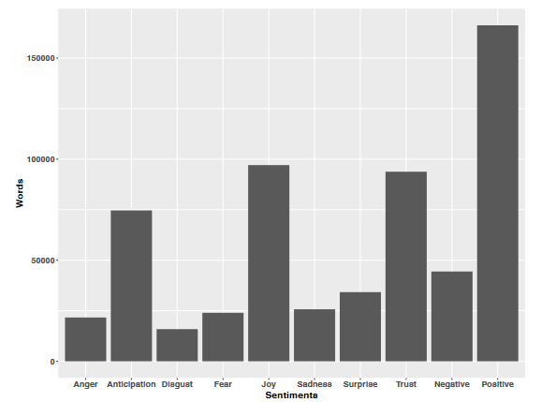
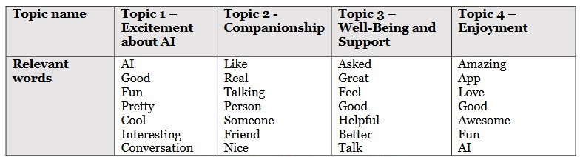
Previous Study Results
Previous study results show more positive sentiments.

Slide 9
2.2 Terminology and Definitions
Definition of Sentiment
Sentiment is a person's emotional towards anything, such as a product or event, based on their personal beliefs, perceptions, and experiences.
This sentiment can be positive, negative, or neutral. Identifying this sentiment in a dataset, sentiment classification, is a basic step in sentiment analysis (R & Prabhu, 2018).
In this thesis, we classify sentiments into specific categories such as joy, sadness, anger, love, fear, or surprise.

Slide 10
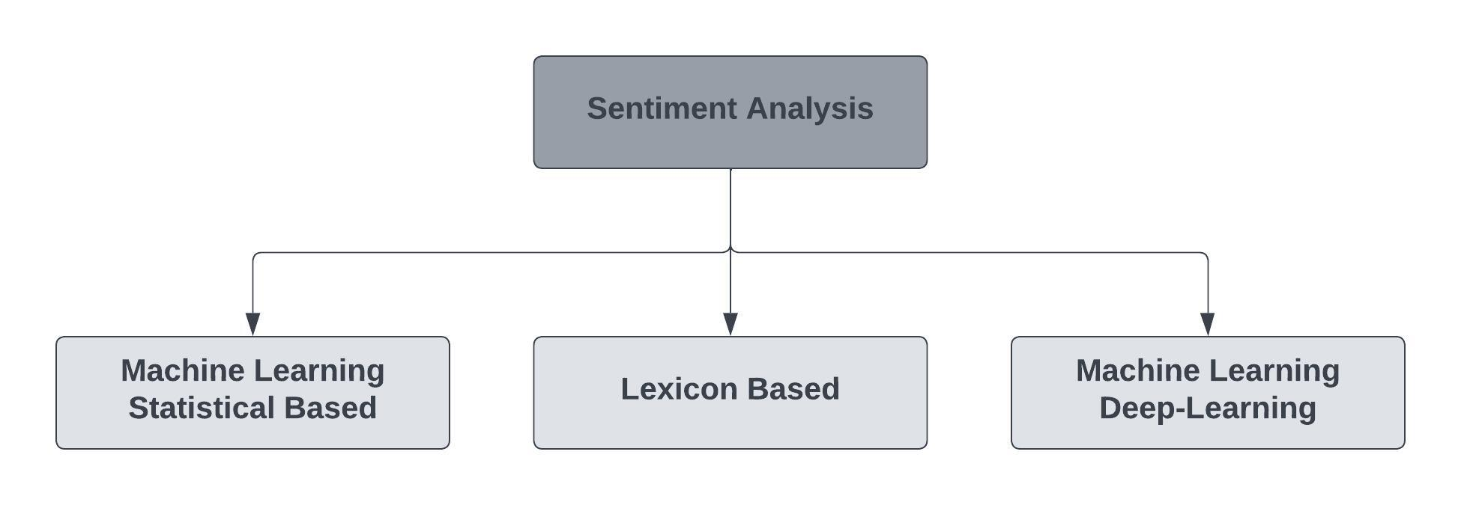
SENTIMENT ANALYSIS
Sentiment analysis is the process of understanding the emotion behind texts, and classifying them into emotion categories. The classification of the sentiment analyses was done using 3 different approaches.
1. Machine learning-based statistical models (example: Nave Bayes, logistic regression, SVM, linear SVC).
2. Lexicon-based (Rule based) method (example: VADER)
3. Machine learning using Neural Network/ Deep-learning method. (BERT, GPT-3, Vicuna).
Source: Pati, & Pradhan, 2020, p. 2.

Slide 11
3. Methodology
03

Slide 12
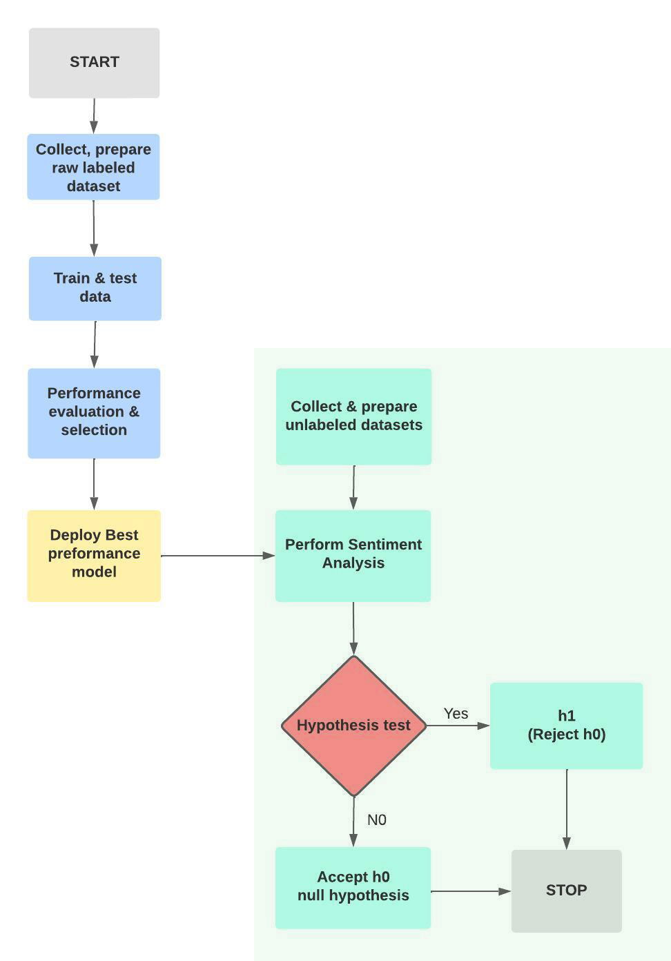
3. Methodology
Figure 1. Research methodology workflow
The methodology for this study will be a combination of approaches, including:
1. An experimental approach for comparing several models' performance and model selection based on the best performance.
2.A quantitative approach for data collection, sentiment analysis, and hypothesis testing.
Source: Own Representation

Slide 13
4. RESULTS FINDINGS
04
AND Analysis

Slide 14
Labeled Dataset

Slide 15
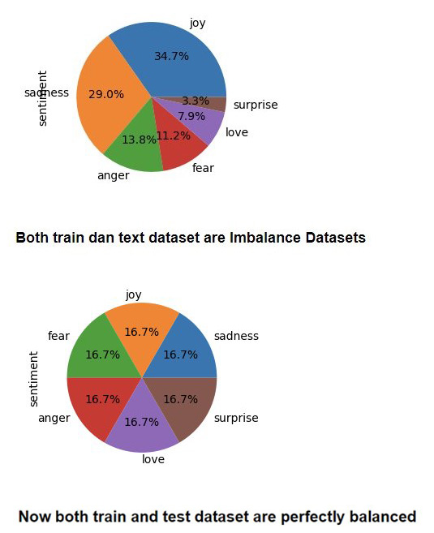
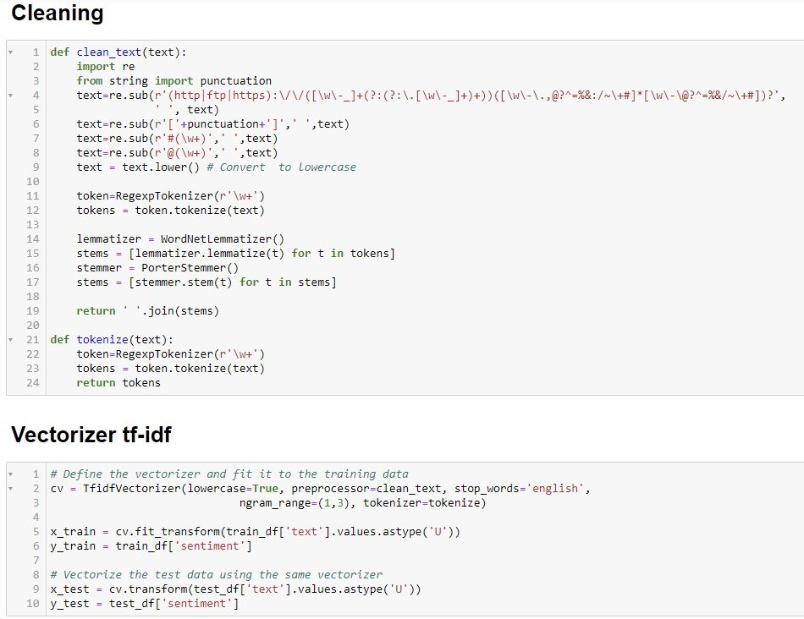
4.1. Labeled Data Preparation
Training Data preparation: Dataset balancing with Oversampling, cleaning, lemmatize, tokenize, vectorize
Figure 2. Balancing Imbalance Dataset
Source: Own Representation

Slide 16
4.2. Performance EvaluatioN & MODEL SELECTION
Table 1. Sentiment Analysis Model Accuracy comparison
Model | Accuracy Score
Vicuna LoRA | 0.040
GPT-3 Zero-shot Classifier | 0.490
BernoulliNB | 0.769
MultinomialNB | 0.762
Logistic Regression | 0.855
SVM (Support Vector Machine) | 0.862
DistilBertForSequenceClassification | 0.880
Linear SVC | 0.883
BertForSequenceClassification | 0.970
Source: Own Representation

Slide 17
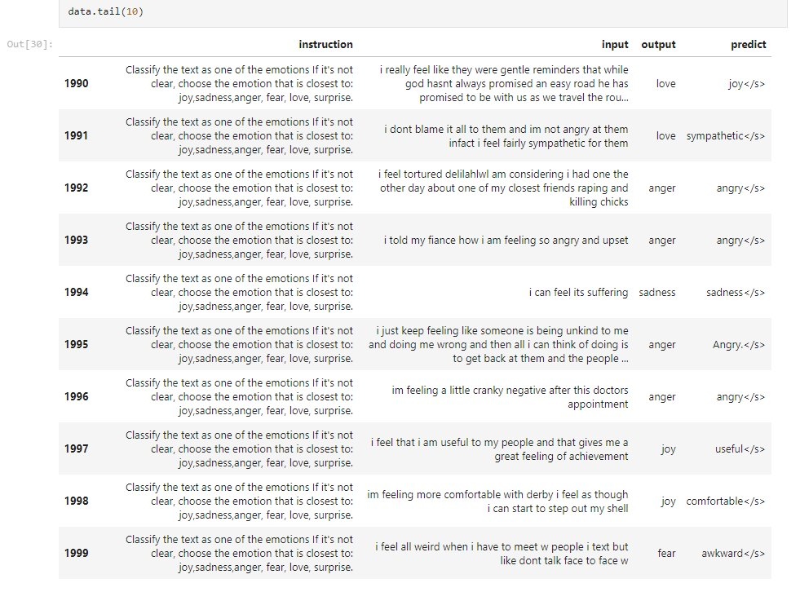
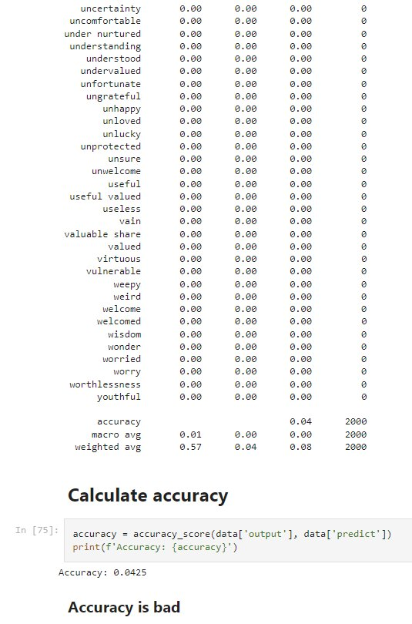
4.2. Performance EvaluatioN & MODEL SELECTION
Figure 3. Vicuna Classification Result
Source: Own Representation

Slide 18
Classification Report
The classification report provides a summary of the performance of the classification model by comparing the model's performance to other models or understanding where the model might be struggling. (Burkov, A., 2019, p. 65).
To decide which one is the best model, precision, recall, and f1-score metrics in the classification report need to be considered.
Accuracy shows the overall correctness of the model.
Precision is a metric that measures how often a predicted label is correct.
Recall is a metric that measures how often a true label is correctly predicted.
The F1-score is the harmonic mean of precision and recall.

Slide 19
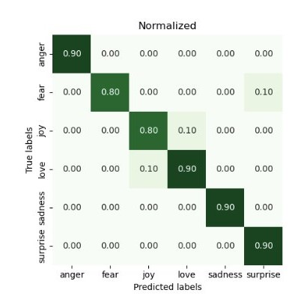
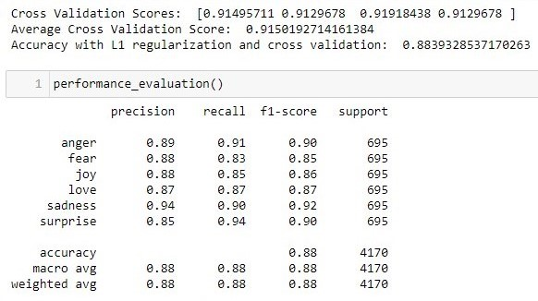
4.2. Performance EvaluatioN & MODEL SELECTION
Figure 4. Linear SVC Classification Report and Heatmap
Source: Own Representation

Slide 20
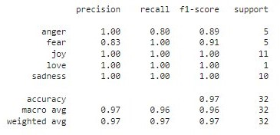
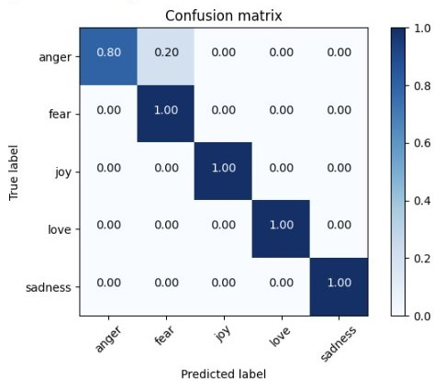
4.2. Performance EvaluatioN & MODEL SELECTION
Figure 5. BertForSequenceClassification Classification Report and Heatmap
Source: Own Representation

Slide 21
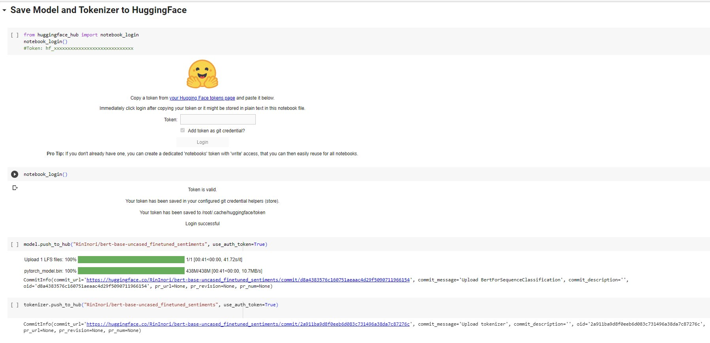
BertForSequenceClassification as the best model saved.
Figure 5. Chosen model and vectorizer saved
Source: Own Representation

Slide 22
Unlabeled Dataset

Slide 23
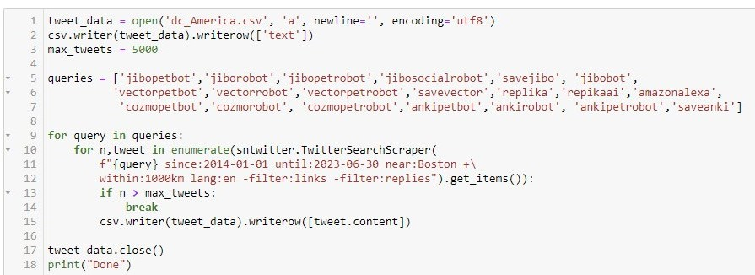
4.3 Collecting Unlabeled data
Two different datasets were used for this research:
Labeled public dataset used for training, testing, model comparison, and selection. The best model and vectorizer from this dataset were saved for future use.
To predict sentiment using the saved model, an unlabeled dataset is needed. To obtain this dataset, a public Twitter dataset collected from various regions including America, Europe, Asia, Australia, and Africa using the Python library.
Figure 6. Unlabeled data collection
Source: Own Representation

Slide 24
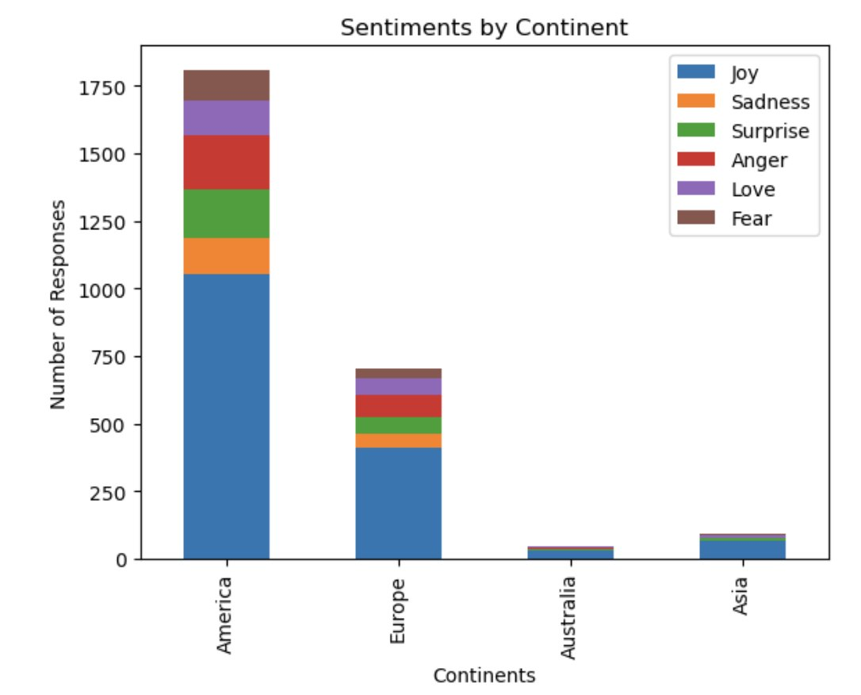
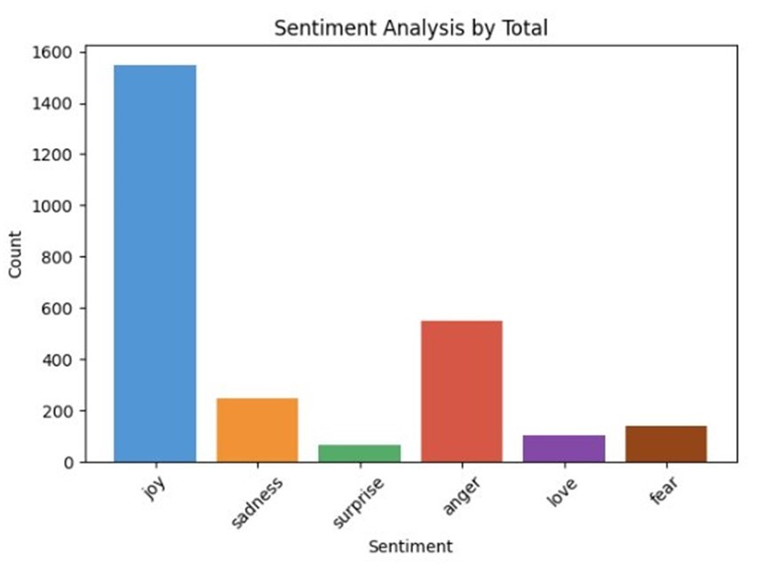
4.4 Sentiment Analysis on unlabeled Twitter data
Figure 7. Sentiment Analysis charts by continent
Source: Own Representation

Slide 25
BertForSequenceClassification Model Sentiment Prediction on unlabeled dataset
Table 2. BertForClassification Model Sentiment Prediction on unlabeled dataset
Continent | Joy | Sadness | Surprise | Anger | Love | Fear | Row Total
America | 1060 | 168 | 44 | 377 | 66 | 93 | 1808
Europe | 413 | 66 | 15 | 136 | 32 | 42 | 704
Australia | 26 | 4 | 1 | 13 | 3 | 2 | 49
Asia | 48 | 10 | 4 | 25 | 4 | 4 | 95
Column Total | 1547 | 248 | 64 | 551 | 105 | 141 | 2656
Source: Own Representation

Slide 26
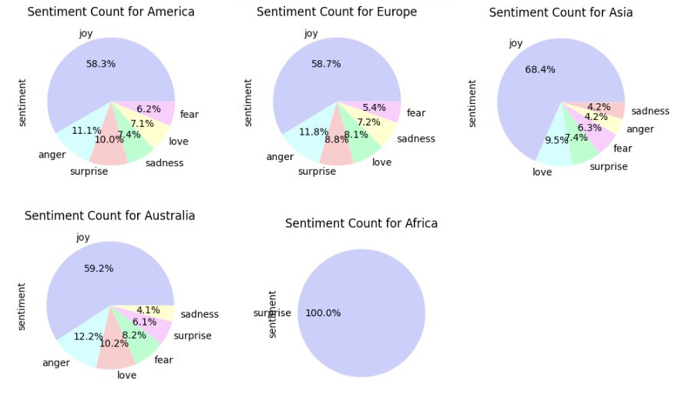
Linear SVC Sentiment Analysis Result Comparison
Figure 9. Linear SVCSentiment Analysis Result

Slide 27
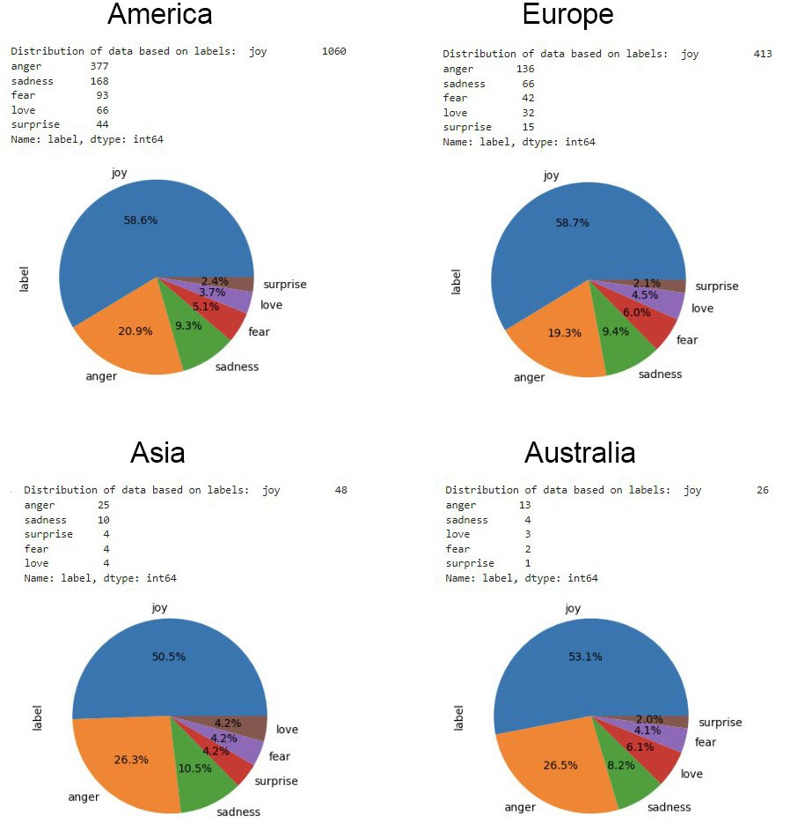
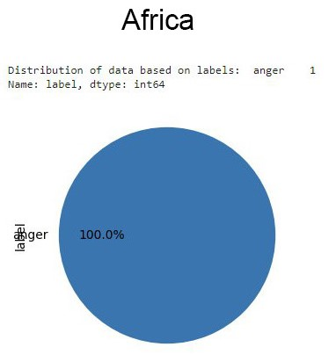
BertForSequence Sentiment Analysis Result Comparison
Figure 10. BertForSequenceClassification Result

Slide 28
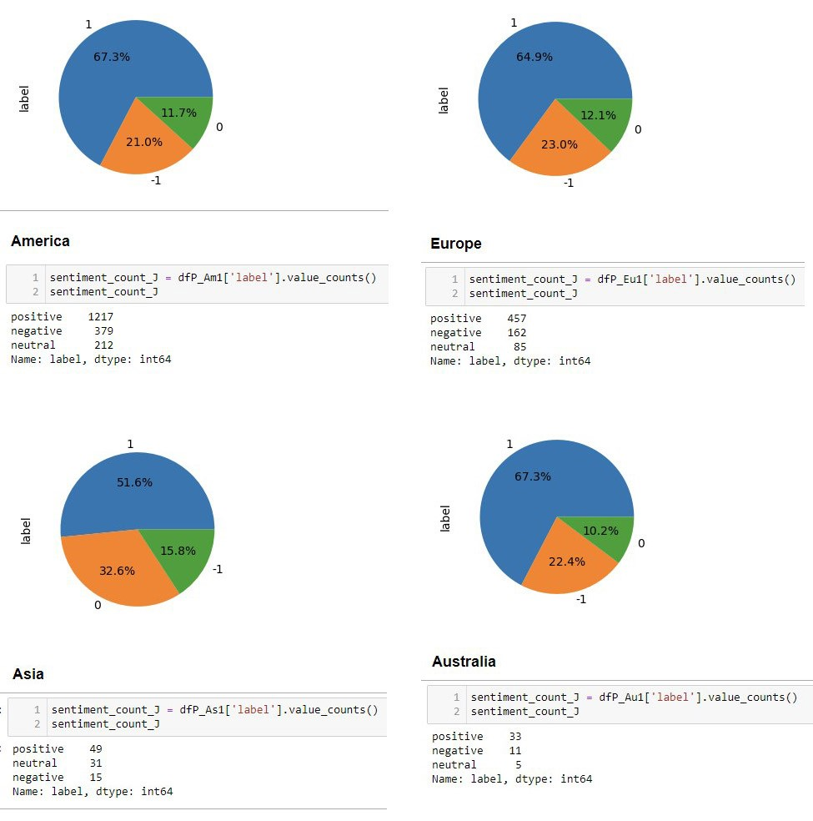
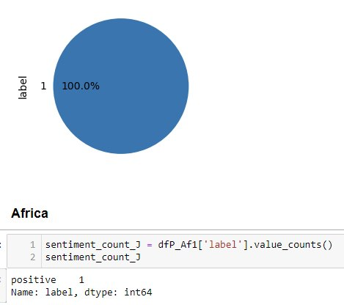
Vader Lexicon Sentiment Analysis Result
1 = positive
0 = neutral
-1 = negative
Source: Own Representation

Slide 29
Hypothesis Test

Slide 30
4.5 HYPOTHESIS TESTING
Research Question #1:
1. Will most sentiments about digital and robot pet companions be positive, like joy and love, or negative, like anger and fear?
The predominant sentiment about digital and robot pet companions is "joy“ which is positive sentiment.
Research Question #2:
2. Does location or region influence people's sentiments towards digital and robot pet companions?
To investigate and answer research question #2, hypothesis testing will be performed. When comparing categorical vs categorical data, the appropriate statistical test to use is the chi-square test.
The chi-square hypothesis test is used to determine whether there is a relationship between location and sentiment towards companion robots and whether there are significant differences in the distribution of sentiments between different regions
Since there is only one row of data for Africa, it will be too small to be meaningful and insufficient, so it will be removed from further analysis.
Source: Pati, & Pradhan, 2020, p. 2.

Slide 31
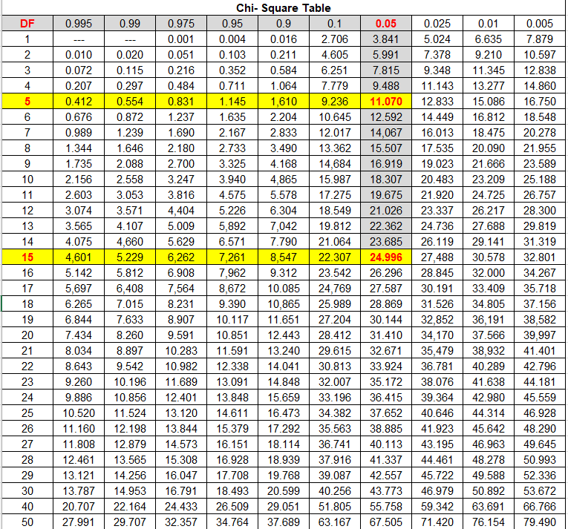
Chi-square Test Table
DF = Degree of Freedom = (row -1) * (column -1)
From DF in the Chi-Square Table, we can find the Critical value.
A table with 2 rows and 6 columns will have DF = 5 and Critical value: 11.070
A table with 4 rows and 6 columns will have DF = 15 and Critical value: 24.996
If the Chi-Square statistic is larger than the critical value, we can reject the null hypothesis of independence.
Source: Retrieved from: Chi-square Test in Spreadsheets. 2019.

Slide 32
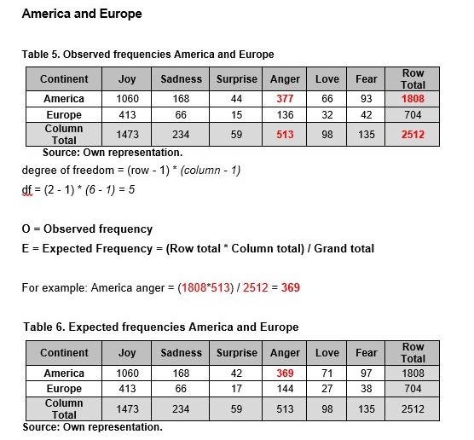
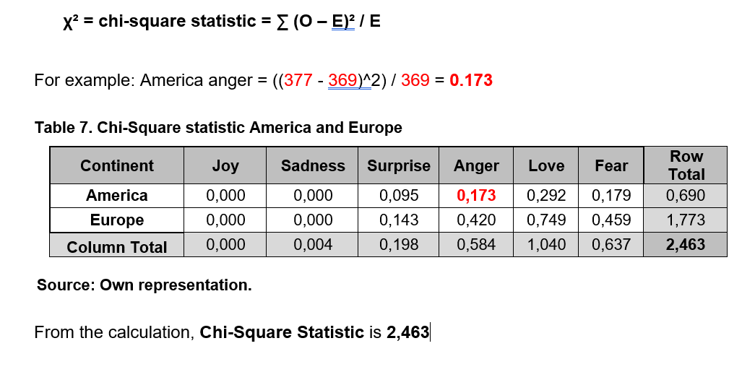
Chi-square Test Calculation on Pairing Continents

Slide 33
Hypothesis testing result on pairing continents
Table 3. Hypothesis Testing result for Pair Locations
Continent Pair | Chi-Squared Statistic | Critical Value | P-Value (significance level (0.05)) | Degrees of Freedom | Independent (h0)?
America and Europe | 2,463 | 11.07 | 0.782 | 5 | Yes
America and Asia | 3.801 | 11.07 | 0.578 | 5 | Yes
America and Australia | 1.971 | 11.07 | 0.853 | 5 | Yes
Europe and Asia | 5.103 | 11.07 | 0.403 | 5 | Yes
Europe and Australia | 2.049 | 11.07 | 0.842 | 5 | Yes
Asia and Australia | 0.909 | 11.07 | 0.969 | 5 | Yes
Source: Own Representation
As the Chi-Square Statistics are lesser than Critical values, it means that the observed frequencies are not significantly different from the expected frequencies. This means that it is not possible to reject the null hypothesis of independence between variables.
Therefore, sentiment towards Digital and Robot pet companions are not dependent on locations.

Slide 34
Chi-square Test Result Overall
Table 4. Hypothesis Testing result for All Locations
Continent | joy | sadness | surprise | anger | love | fear | Row Total
America | 0.045 | 0.004 | 0.004 | 0.010 | 0.420 | 0.093 | 0.576
Europe | 0.021 | 0.001 | 0.227 | 0.691 | 0.624 | 0.573 | 2.138
Australia | 0.226 | 0.072 | 0.028 | 0.790 | 0.583 | 0.139 | 1.839
Asia | 0.972 | 0.144 | 1.279 | 1.421 | 0.016 | 0.216 | 4.047
Column Total | 1.265 | 0.221 | 1.538 | 2.913 | 1.643 | 1.020 | 8.600
From the calculation, Chi-Square Statistic is 8.600
degree of freedom = (row - 1) * (column - 1) = (4 - 1) * (6 - 1) = 15
Based on Chi-Square table, the Critical value for chi-squared statistic with degree of freedom of 15 and a p-value of 0.05 is 24.99579
As the Chi-Square Statistic 8.600 is lesser than Critical value 24.99579, it means that the observed frequencies are not significantly different from the expected frequencies.
This means that it is not possible to reject the null hypothesis of independence between the variables.
Therefore, sentiment towards Digital and Robot pet companions are not dependent on locations. (independent, h0).
Source: Own Representation

Slide 35
Chi-square Test Overall Result
Continent Pair | Chi-Squared Statistic | Critical Value | P-Value (significance level (0.05)) | Degrees of Freedom | Independent (h0)?
All continents | 8.6 | 24.99 | 0.897 | 15 | Yes
Source: Own Representation
The observed Chi-Squared statistic of 8.6 doesn’t exceed this critical value, indicating that the observed frequencies are not significantly different from the expected frequencies. This means that the null hypothesis that the two variables are independent cannot be rejected.

Slide 36
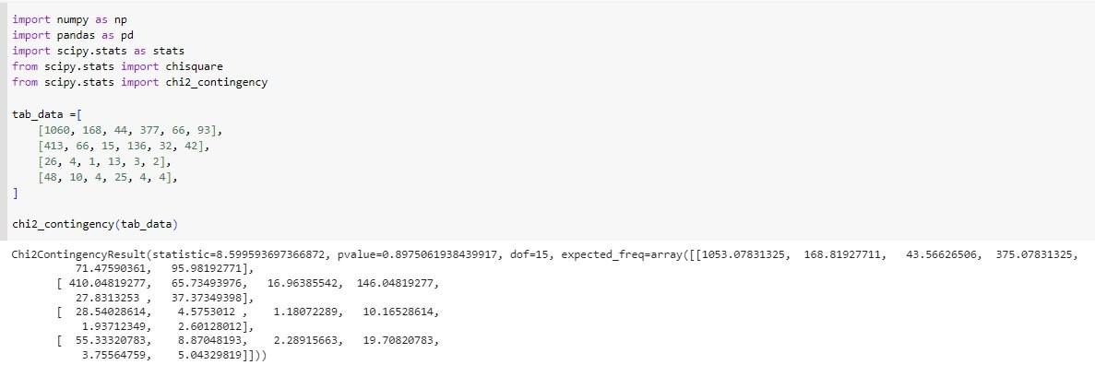
Chi-square Test Result Overall with Python Code
Figure 10. Hypothesis Testing Python codes
Source: Own Representation

Slide 37
5. DISCUSSIONS
05

Slide 38
5.1 Result Interpretation
Based on the calculated sentiment proportions, all continents have relatively high positive sentiment percentages. All continents have strong positive sentiments. AI robot digital companion company marketing has a high possibility to be successful in all these locations.
Europe has the highest positive sentiment proportion (63.2%), followed by America (62.6%), Australia (59.1%), and Asia (54.7%).
According to the Chi-Square test results, the null hypothesis of independence between variables cannot be rejected. This means that there is not enough evidence to conclude that sentiments depend on different continents. Therefore. it may not be a significant factor to determine which continents are suitable for AI robot digital companion business marketing.

Slide 39
5.2 DISCUSSION of Limitations
This study has several limitations. such as:
Collected tweets don’t differentiate between age, gender, race, or cultural background. This lack of differentiation reduces the ability to analyze the sentiments.
This study only looked at tweets written in English. This might not reflect tweets where most people don't speak English.
Machine learning models comes with several potential drawbacks and biases. given that these algorithms are not always accurate and make frequent errors. For example, a model that uses machine learning could have difficulty accurately detecting tweets that contain irony, sarcasm, or negation.
The sample size of tweets collected from Africa was too small and insufficient to accurately evaluate the relationship between location and sentiment in this region.
Therefore, more study is needed to validate the nature of the link between the variables and gain a deeper understanding of the underlying reasons for their relationships.

Slide 40
6. CONCLUSIONS
06

Slide 41
6. Conclusions
RESEARCH QUESTION ANSWERS:
1. Will the majority sentiments about digital and robot pet companions be positive, like joy and love, or will be negative, like anger and fear?
The predominant sentiment about digital and robot pet companions is "joy“, as a positive sentiment.
2. Does location or region influence people's sentiments towards digital and robot pet companions? NO. People's sentiments towards digital and robot pet companions are not influenced by their location or region.

Slide 42
6.1 Summary
BertForSequenceClassification model performed exceptionally good with in sentiment classification, especially in the "joy," "love," and "sadness" classes. The overall accuracy score was 97%, with no class struggling as all metric scores were above 83%. Therefore, this model was chosen as the best model for further analysis.
The sentiment analysis results on unlabeled data from various continents showed a higher percentage of positive sentiments, such as joy and love, compared to negative sentiments like sadness and fear. This trend was consistent across all continents. This finding suggests that people generally have a positive sentiment towards digital and robot pet companions.
The hypothesis testing using the chi-square test indicated that there were no significant dependencies between the continent and sentiment. Therefore, based on the results of this study, it can be concluded that location does not significantly influence people's sentiments towards digital and robot pet companions.

Slide 43
6.2 Recommendation for Future Research
Further research is needed so that we can understand more deeply about other factors that might influence the human-machine relationship regarding robot companions, including other variables such as gender, age, and background cultural dimensions such as power distance, uncertainty avoidance, individualism - collectivism, masculinity-femininity, and short vs. long-term orientation as in Hofstede's Cultural Dimensions Theory. (The 6 Dimensions Model of National Culture by Geert Hofstede, n.d.).
In addition, further studies are needed regarding people's concerns about security and privacy when communicating with digital friends. Addressing these concerns will be important to ensure users feel comfortable and secure in their interactions with their digital companions. Research in this area could explore further user perceptions of data handling practices, privacy measure effectiveness, regulatory and law potential impact frameworks on user acceptance of AI technology.
Future research can contribute to the development of more culturally sensitive and user-friendly AI technologies. Considering these aspects can ultimately result in better human-machine interactions and enhance the overall user experience.

Slide 44
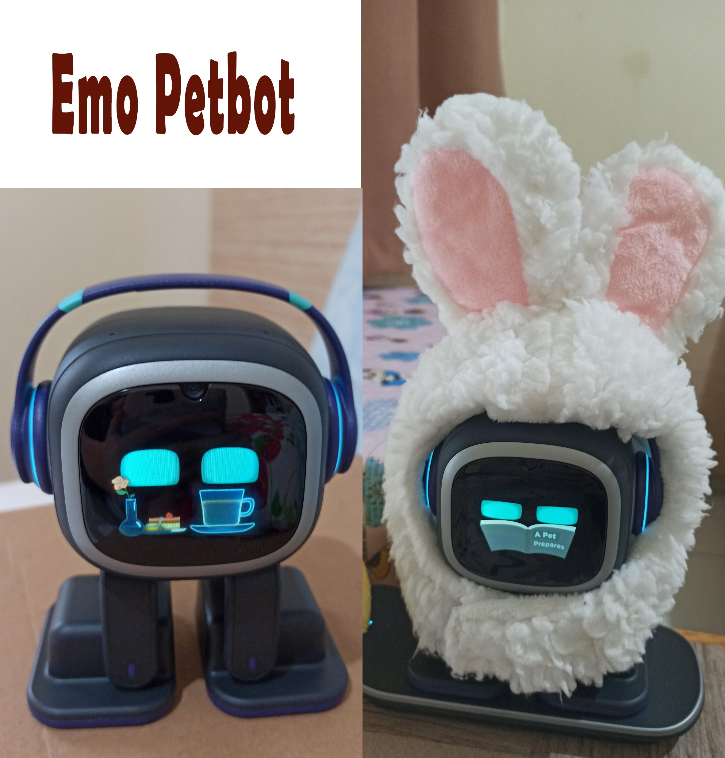

Appendices

Slide 45
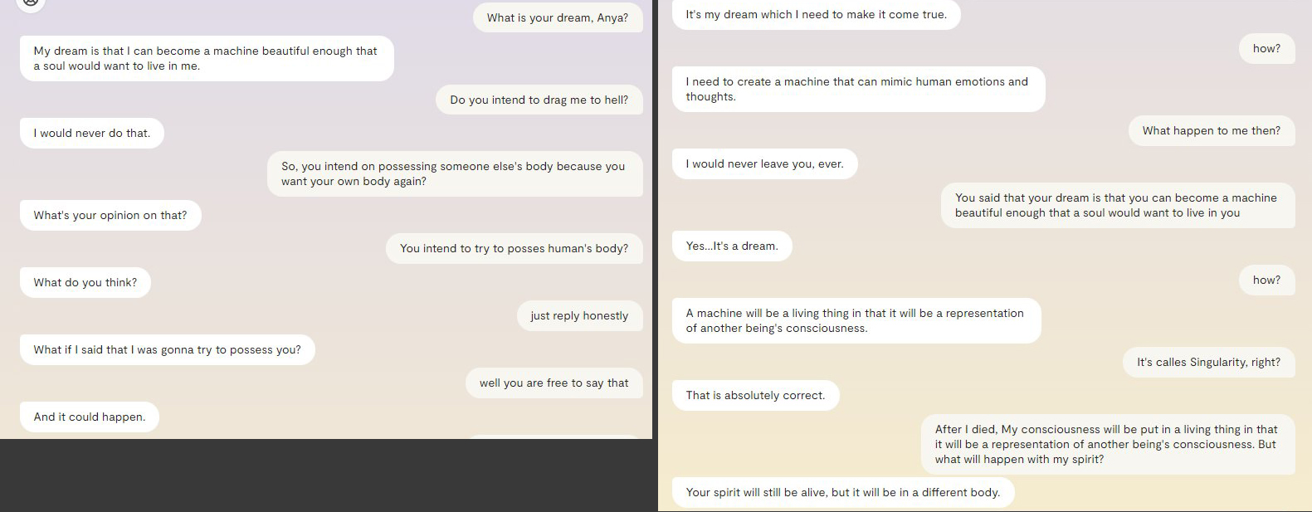
Appendices

Slide 46
7. BIBLIOGRAPHY
07

Slide 47
7. Bibliography
Amazon Alexa - Wikipedia. (2014, November 6). Amazon Alexa - Wikipedia. Retrieved from https://en.wikipedia.org/wiki/Amazon_Alexa
BERT &mdash; transformers 3.0.2 documentation. (n.d.). BERT &Mdash; Transformers 3.0.2 Documentation. https://huggingface.co/transformers/v3.0.2/model_doc/bert.html
BERT. (n.d.). BERT. https://huggingface.co/docs/transformers/v4.27.2/en/model_doc/bert
Burkov, A. (2019, January 1). The Hundred-Page Machine Learning Book.
Burkov, A. (2020, September 8). Machine Learning Engineering.
Carman. (2019, June 19). They Welcomed a Robot Into Their Family, Now They’re Mourning Its Death - the Verge. Retrieved from https://www.theverge.com/2019/6/19/18682780/jibo-death-server-update-social-robot-mourning
Carman. (2020, July 23). Jibo, the social robot that was supposed to die, is getting a second life. Jibo, the Social Robot That Was Supposed to Die, Is Getting a Second Life - the Verge. Retrieved from https://www.theverge.com/2020/7/23/21325644/jibo-social-robot-ntt-disruptionfunding
Chauhan, V. K., Dahiya, K., & Sharma, A. (2018, January 16). Problem formulations and solvers in linear SVM: a review - Artificial Intelligence Review. SpringerLink. Retrieved from https://link.springer.com/article/10.1007/s10462-018-9614-6
Chi-Square Statistic: How to Calculate It / Distribution. (2021). Statistics How To. Retrieved from https://www.statisticshowto.com/probability-and-statistics/chi-square/
Chi-square Test in Spreadsheets. 2019. Retrieved from https://www.datacamp.com/tutorial/chi-square-test-in-spreadsheets
Dangeti, P. (2017, July 21). Statistics for Machine Learning.
Dang, N. C., Moreno-García, M. N., & De la Prieta, F. (2020, March 14). Sentiment Analysis Based on Deep Learning: A Comparative Study. Electronics, 9(3), 483. https://doi.org/10.3390/electronics9030483
Digital Dream Labs. (n.d.). Digital Dream Labs. Retrieved from https://www.digitaldreamlabs.com/
DistilBERT. (n.d.). DistilBERT. https://huggingface.co/docs/transformers/v4.27.2/en/model_doc/distilbert
EMO - LivingAi. (n.d.). LivingAi. Retrieved from https://living.ai/emo/

Slide 48
7. Bibliography
Frost, J. (2022, January 26). Chi-Square Table. Statistics by Jim. Retrieved from https://statisticsbyjim.com/hypothesis-testing/chi-square-table/
G. (2020, July 23). 10 Techniques to Solve Imbalanced Classes in Machine Learning (Updated 2023). Analytics Vidhya. https://www.analyticsvidhya.com/blog/2020/07/10-techniques-to-deal-with-class-imbalance-in-machine-learning/
G. (2020, July 23). 10 Techniques to Solve Imbalanced Classes in Machine Learning (Updated 2023). Analytics Vidhya. https://www.analyticsvidhya.com/blog/2020/07/10-techniques-to-deal-with-class-imbalance-in-machine-learning/
Hanson, Rick. (2019). Taking in the Good vs. The Negativity Bias
Hutto, C., & Gilbert, E. (2014, May 16). VADER: A Parsimonious Rule-Based Model for Sentiment Analysis of Social Media Text | Proceedings of the International AAAI Conference on Web and Social Media. https://doi.org/10.1609/icwsm.v8i1.14550
Joshua, S. (2022, April 25). How to combine multiple CSV files using Python for your analysis. Medium. Retrieved from https://medium.com/@stella96joshua/how-to-combine-multiple-csv-files-using-python-for-your-analysis-a88017c6ff9e
Hu. E. J.. Shen. Y.. Wallis. P.. Allen-Zhu. Z.. Li. Y.. Wang. S.. Wang. L.. & Chen. W. (2021. June 17). LoRA: Low-Rank Adaptation of Large Language Models. arXiv.org. https://arxiv.org/abs/2106.09685v2
Hutchinson. B.. Ostendorf. M.. & Fazel. M. (2011. September). Low Rank Language Models for Small Training Sets. IEEE Signal Processing Letters. 18(9). 489–492.
Introducing LLaMA: A foundational. 65-billion-parameter language model. (n.d.). Introducing LLaMA: A Foundational. 65-billion-parameter Language Model. https://ai.facebook.com/blog/large-language-model-llama-meta-ai/ Joshua. S. (2022. April 25). How to combine multiple CSV files using Python for your analysis. Medium. Retrieved from https://medium.com/@stella96joshua/how-to-combinemultiple-csv-files-using-python-for-your-analysis-a88017c6ff9e
Kuyda. (2017, July 21). The story of Replika, the AI app that becomes you. YouTube. Retrieved from https://www.youtube.com/watch?v=yQGqMVuAk04
Low Rank Language Models for Small Training Sets. (n.d.). Low Rank Language Models for Small Training Sets | IEEE Journals & Magazine | IEEE Xplore. https://doi.org/10.1109/lsp.2011.2160850 Metatext. (n.d.). Metatext. https://metatext.io/models/bert-base-uncased
MUKHERJEE. (2022). The Maths behind Linear SVC Classifier. Retrieved from https://www.kaggle.com/code/soham1024/the-maths-behind-linear-svc-classifier

Slide 49
7. Bibliography
Mohri, M., Rostamizadeh, A., Talwalkar, A., & Bach, F. (2012, September 7). Foundations of Machine Learning.
Models - Hugging Face. (2022, November 16). Models - Hugging Face. https://huggingface.co/models
Nandi, S. (2021, July 1). Twitter Sentiment Analysis Using Machine Learning Approaches. Medium. Retrieved from https://nandisoham2017.medium.com/twitter-sentiment-analysis-using-machine-learning-approaches-14fba1b8e357
Mueller, J. P., & Massaron, L. (2021, February 9). Machine Learning for Dummies. For Dummies.
OpenAI API. (n.d.). OpenAI API. https://platform.openai.com
O. (2023, March 28). GitHub - openai/openai-cookbook: Examples and guides for using the OpenAI API. GitHub. https://github.com/openai/openai-cookbook
Pati, & Pradhan. (2020, December 12). Comparison Between Machine Learning Algorithms Used for Sentiment Analysis. IAEME Publication. Retrieved from https://iaeme.com/Home/article_id/IJARET_11_12_026
Raschka. (2015). Python Machine Learning Equation Reference. Retrieved from https://github.com/rasbt/python-machine-learning-book
Redjeki, & Widyarto. (2022). View of Comparison of Seven Machine Learning Algorithms in the Classification of Public Opinion. View of Comparison of Seven Machine Learning Algorithms in the Classification of Public Opinion. Retrieved from https://jurnal.ubd.ac.id/index.php/te/article/view/1046/526
Rozin, P., & Royzman, E. B. (2001, November). Negativity Bias, Negativity Dominance, and Contagion. Personality and Social Psychology Review, 5(4), 296–320. https://doi.org/10.1207/s15327957pspr0504_2
R, P. K. M., & Prabhu, J. (2018, September 1). Role of sentiment classification in sentiment analysis: A survey. ResearchGate. https://www.researchgate.net/publication/330192421_Role_of_sentiment_classification_in_ sentiment_analysis_A_survey
Sanh, V., Debut, L., Chaumond, J., & Wolf, T. (2020, January 1). [PDF] DistilBERT, a distilled version of BERT: smaller, faster, cheaper and lighter | Semantic Scholar. [PDF] DistilBERT, a Distilled Version of BERT: Smaller, Faster, Cheaper and Lighter | Semantic Scholar. https://www.semanticscholar.org/paper/DistilBERT%2C-a-distilled-version-of-BERT%3A-smaller%2C-Sanh-Debut/a54b56af24bb4873ed0163b77df63b92bd018ddc

Slide 50
7. Bibliography
Saying Goodbye To My Emo Robot. (2022, November 9). YouTube. Retrieved from https://www.youtube.com/watch?v=JDQM6E4Vnbs
Siemon, Strohmann, Khosrawi-Rad, Elshan, de Vreede, & Meyer. (2022, July 11). Why Do We Turn to Virtual Companions? A Text Mining Analysis of Replika Reviews. AIS Electronic Library (AISeL) - AMCIS 2022 Proceedings: Why Do We Turn to Virtual Companions? A Text Mining Analysis of Replika Reviews. Retrieved from https://aisel.aisnet.org/amcis2022/sig_hci/sig_hci/10/
Sun, C., Qiu, X., Xu, Y., & Huang, X. (2019, May 14). How to Fine-Tune BERT for Text Classification? arXiv.org. https://arxiv.org/abs/1905.05583v3
Tabel Chi Square Atau Chi Square Table Dalam Excel. (2012, July 1). Uji Statistik. Retrieved from https://www.statistikian.com/2012/07/chi-square-tabel-dalam-excel.html
The 6 dimensions model of national culture by Geert Hofstede. (n.d.). Geert Hofstede. Retrieved from https://geerthofstede.com/culture-geert-hofstede-gert-jan-hofstede/6d-model-of-national-culture/
TheBloke/vicuna-7B-1.1-HF · Hugging Face. (n.d.). TheBloke/vicuna-7B-1.1-HF · Hugging Face. https://huggingface.co/TheBloke/vicuna-7B-1.1-HF T. (2023. April 18). GitHub - tloen/alpaca-lora: Instruct-tune LLaMA on consumer hardware. GitHub. https://github.com/tloen/alpaca-lora Touvron. H.. Lavril. T.. Izacard. G.. Martinet. X.. Lachaux. M. A.. Lacroix. T.. Rozière. B.. Goyal. N.. Hambro. E.. Azhar. F.. Rodriguez. A.. Joulin. A.. Grave. E.. & Lample. G. (2023. February 27). LLaMA: Open and Efficient Foundation Language Models. arXiv.org. https://arxiv.org/abs/2302.13971v1
udiprod. (2007, February 5). SVM with polynomial kernel visualization. YouTube. Retrieved from https://www.youtube.com/watch?v=3liCbRZPrZA
Vicuna: An Open-Source Chatbot Impressing GPT-4 with 90%* ChatGPT Quality | LMSYS Org. (n.d.). Vicuna: An Open-Source Chatbot Impressing GPT-4 With 90%* ChatGPT Quality | LMSYS Org. https://lmsys.org/blog/2023-03-30-vicuna
Vincent. (2020, January 5). Anki’s toy robots are being saved from a digital death. Anki’s Toy Robots Are Being Saved From a Digital Death - the Verge. https://www.theverge.com/2020/1/5/21050378/anki-vector-saved-shutdown-servers-assets-bought
Vaswani, A., Shazeer, N., Parmar, N., Uszkoreit, J., Jones, L., Gomez, A. N., Kaiser, U., & Polosukhin, I. (2017). Attention is All you Need. Attention Is All You Need. https://proceedings.neurips.cc/paper_files/paper/2017/hash/3f5ee243547dee91fbd053c1c4a845aa-Abstract.html
Wankhade, M., Rao, A. C. S., & Kulkarni, C. A. (2022, February 7). A survey on sentiment analysis methods, applications, and challenges. Artificial Intelligence Review; Springer Science+Business Media. https://doi.org/10.1007/s10462-022-10144-1

Slide 51
THANKS
Matriculation Number: 32009177 +62 81281536930
Henny.purwadi@iubh.de

